Slide 1
Complex Event Processing Systems
Pravin Y Pawar

Slide 2
Complex Event Processing
Origins
Complex event processing, or CEP, consists of a set of concepts and techniques developed in the early 1990's for processing real-time events and extracting information from event streams as they arrive.
The goal of complex event processing is to identify meaningful events (such as opportunities or threats) in real-time situations and respond to them as quickly as possible.
For example,
Among thousands of incoming events, a monitoring system may for instance receive the following three from the same source:
church bells ringing.
the appearance of a man in a tuxedo with a woman in a flowing white gown.
rice flying through the air.
From these events the monitoring system may infer a complex event: a wedding.
CEP as a technique helps discover complex events by analyzing and correlating other events: the bells, the man and woman in wedding attire and the rice flying through the air.

Slide 3
Complex Event Processing (2)
Working
Complex event processing (CEP) addresses exactly problem of matching continuously incoming events against a pattern.
The result of a matching are usually complex events which are derived from the input events.
In contrast to traditional DBMSs where a query is executed on stored data, CEP executes data on a stored query.
All data which is not relevant for the query can be immediately discarded.
The advantages of this approach are obvious, given that CEP queries are applied on a potentially infinite stream of data.
Furthermore, inputs are processed immediately.
Once the system has seen all events for a matching sequence, results are emitted straight away.
This aspect effectively leads to CEP’s real time analytics capability.
Source : https://flink.apache.org/news/2016/04/06/cep-monitoring.html

Slide 4
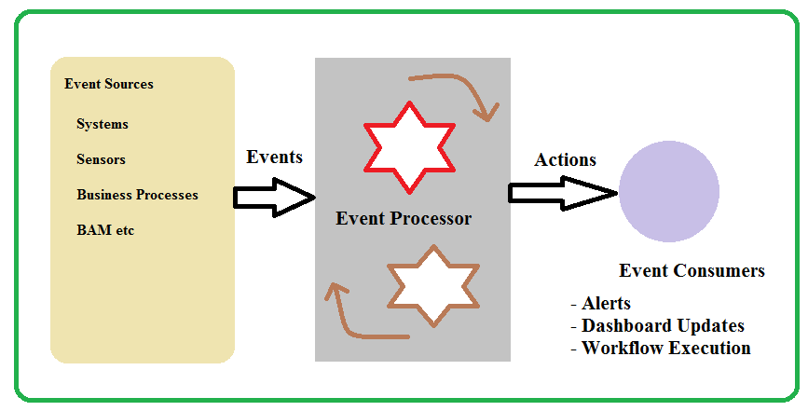
Complex Event Processing (3)
Defined
Complex event processing is an organizational tool that helps to aggregate a lot of different information and that identifies and analyzes cause-and-effect relationships among events in real time.
CEP matches continuously incoming events against a pattern and provides insight into what is happening and allows you to proactively take effective actions.
Adapted from https://databricks.com/glossary/complex-event-processing

Slide 5
CEP Applications
Major application areas for Complex Event Processing (CEP):
Business Activity Monitoring aims at identifying problems and opportunities in early stages by monitoring business processes and other critical resources.
Sensor Networks that are used for monitoring of industrial facilities. These are usually derived from raw numerical measurements (e.g., temperature, smoke).
Market data such as stock or commodity prices; they need to be derived from several events and their relationships through CEP.
Adapted from https://databricks.com/glossary/complex-event-processing

Slide 6
CEP Tools
The most common tools used for Complex Event Processing are:
Apache Flink used by data Artisans
Apache Samza used by LinkedIn
Amazon Kinesis Analytics
Microsoft Azure Stream Analytics, Stream Insight
IBM Streams, Operational Decision Manager (ODM)
Oracle Stream Analytics and Stream Explorer

Slide 7
Difference between CEP and Streaming Engines
Stream Processing Engines tend to be distributed and parallel natively (10-100s of nodes) as oppose to CEP engines tends to be more centralized ( 2 or few nodes).
With most Stream Processing Engines, you need to write code. Also it force you to implement higher order operators like Windows, Temporal Patterns, and Joins yourself while CEP engines support them natively. CEP engines often have a SQL like query language.
Due to their stock market based history, CEP engines are tuned for low latency. Often they respond within few milliseconds and sometimes sub milliseconds. In contrast, most Stream processing engines takes close to a second to generate results.
Stream Processing engines focus on reliable message processing while CEP engines have often opt to throw away some events when failure happens and continue. ( Yes this is changing now with new use cases).
Source : https://www.quora.com/How-is-stream-processing-and-complex-event-processing-CEP-different

Slide 8
Thank You!
In our next session: Streaming Data Systems Architecture

